Slide 1
Web Summer Coaching 2020
S. S. Khanna Girls’ Degree College, Allahabad
22nd May, 2020-21st June, 2020

Slide 2
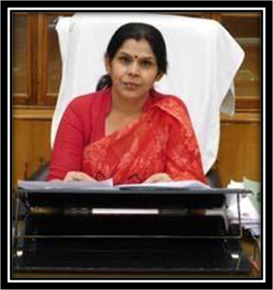
Dear Students,
Greetings!!
I am writing this to give my sincere message to all my beloved students about being safe and healthy by staying at home and making yourself ready for upcoming circumstances. However, the prevailing circumstances don’t allow us to move out for any reason if not important so, we are heading towards Summer Coaching which will be executed through online classes/sessions. With my best hopes that, these classes will give you benefits regarding different kinds of upcoming exams in near future.
Kindly take this message seriously and put your sincere efforts to keep in touch with the messages forwarded to get the benefit of these online classes.
Blessings
Prof. Lalima Singh
Principal
S. S. Khanna Girls’ Degree College,
Prayagraj

Slide 3
What purpose does it serve ?
The summer coaching at the S.S. Khanna Girls Degree College is multifaceted and appeals to a good number of young women who wish to enhance their employability by improving on a key number of skillsets. Today’s job market is complex and hypercompetitive as each year millions of young people become part of the workforce; therefore, at S.S. Khanna we believe that additional training on top of conventional degree programmes is required for young female students to become job ready and contribute to the nation’s need in the modern, globalized world. While a regular degree programme in the Arts or the Sciences is traditionally geared toward theory, the aim of the Summer Coaching is to provide practical skills to candidates that become part of our ambitious programme so that they are confident in pushing themselves forward on the path of upward social mobility.
The Summer coaching programme benefits the young students tremendously from teaching and direction of our highly qualified and dedicated faculty members in various disciplines. The learned professors provide valuable guidance on key aspects of competitive exams such as the All India Civil Services, the Provincial Civil Services (PCS), SSC, as well as many more exams that attract millions of graduates each year. Given that most for-profit coaching institutions areout of reach for the financially weaker section given their steep fee demands, at S.S. Khanna we do it for a negligible sum. Our motive here is to enable young women from weaker socio-economic conditions; to give wings to their dreams. The doors of the programme has been opened up to the women students of other colleges also, who would want to benefit and make use of the programme.

Slide 4
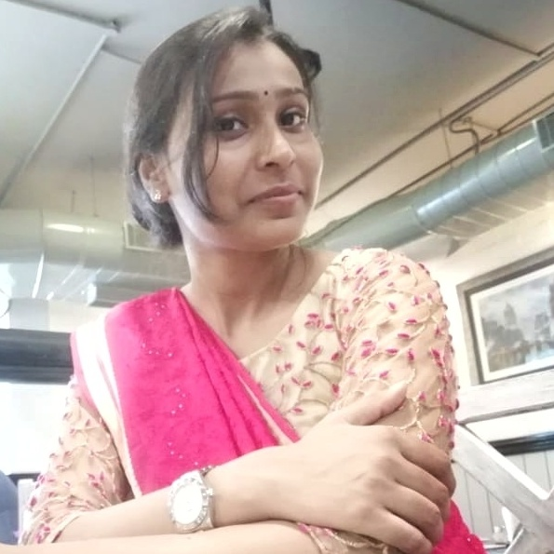
प्रिय छात्राओं
web summer coaching 2020 की कक्षाएं आज
से प्रारंभ हो रही हैं। इस प्रशिक्षण कार्यक्रम का ध्येय उन
प्रतिभाओं को आकाश प्रदान करना है जो शिक्षा के
व्यवसायियों के सामने घुटने टेक कर अपने सपनों को
साकार करने की राह पर डगमगा जाते हैं। उज्ज्वल भविष्य की मोटी कीमत लेने वाले उन व्यावसायिक शिक्षण संस्थानों का उद्देश्य मात्र धनार्जन है किंतु सदनलाल सांवलदास खन्ना महिला महाविद्यालय के इस ग्रीष्मकालीन प्रशिक्षण कार्यक्रम के अंतर्गत गलाकाट प्रतिस्पर्धा के दौर में आर्थिक अभाव के कारण पर्याप्त मार्गदर्शन ना पाकर गुमराह होने वाली छात्राओं को उचित दिशा दिखाने का काम किया जाएगा। इस प्रोग्राम में कुशल शिक्षकों के माध्यम से सिविल सेवा एवं अन्य परीक्षाओं में सफलता प्राप्त करने के लिए निःशुल्क प्रशिक्षण प्रदान किया जाएगा ताकि धनाभाव किसी भी प्रतिभाशाली छात्रा के मार्ग में व्यवधान ना उत्पन्न कर सके ।
सौम्या कृष्ण
समन्वयक आनलाइन ग्रीष्मकालीन प्रशिक्षण कार्यक्रम

